Slide 1

Xamarin Android Apps in GPU Wonderland
.NetFringe2016

Slide 2

rabeb@womenwhocode.com
Rabebothmani.com
@Rabeb_Othmani

Slide 3
Notes:
*any application success especially mobile apps depends on the end user experience.
The app should be performing otherwise if it’s crashing all the time or slow, the user will get rid of it, rated badly on the play store.
That’s why we need to diagnose & profile the app to optimize it.

Slide 4
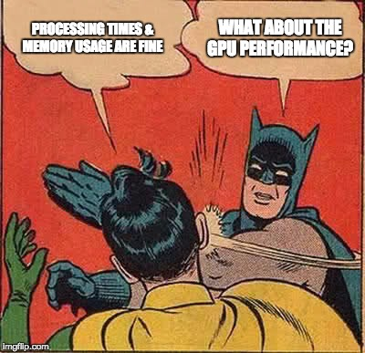
Notes:
Devs tend to take into consideration battery problems, how to handle performance problems associated with compute and memory but tend to forget about the gpu.
They tend to forget that beautiful visuals come with performance cost.
→ Rendering performance is one of the biggest pitfalls devs, fall into.

Slide 5
!6
16ms/frame
Notes:
The system will attempt to redraw the screen in 16ms.
16ms comes from the phone hardware, it defines how fast the screen can update itself in a single second.
If you miss that, you get a dropped frame → jank experience / Lag

Slide 6
GPU Rendering Pipeline
CPU
Input
Invalidate
GPU
Rasterization
Measure/Layout
Display list
Notes:
Rendering pipeline : CPU + GPU working together
CPU : take objects (buttons, lists…) transform them into polygons and textures then move them to the GPU
GPU: Rasterization which is taking high level object and turn it into pixels on the screen.

Slide 7
GPU Problem: Overdraw
GPU
CLipRect
Rasterization
Overdraw
Show GPU Debug
Remove Background

Slide 8
Demo

Slide 9
CPU Problem: Nested Hierarchies
CPU
Input
Invalidate
Hierarchy Viewer
Flatten Hierarchy
Layouts & Invalidations
Measure/Layout
Display List

Slide 10
Demo

Slide 11
Thank you ☺
rabeb@womenwhocode.com
Rabebothmani.com
@Rabeb_Othmani

